Slide 1
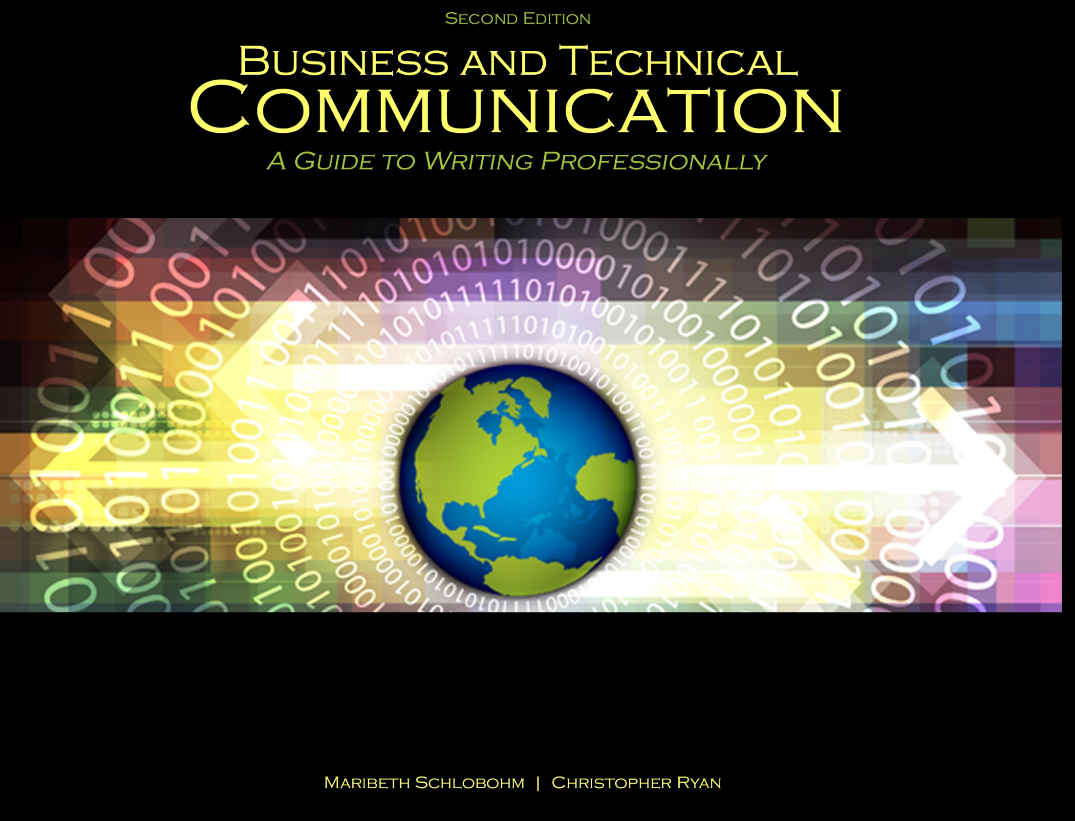
Chapter 10: Social Media and Intellectual Property

Slide 2

Social Networking Defined
“[T]he ability to establish an online profile designed to both set forth individual belief systems and establish online networking with strangers who may or may not share those individual belief systems.”[1]

Slide 3
Social Networking Site Usage
82% of American adults use the internet [2]
66% of Americans have high-speed broadband [2]
65% of American adults use social networking[3]
37% of companies use social media in employment decisions [4]
65% of this 37% of employers data mine Facebook [4]

Slide 4
Screen Reading: the “F” Pattern
We read 25% slower in screen than in print[5]
We read/scan in screen in an “F” pattern
First two paragraphs
Headings and first few lines
Then, just headings
F

Slide 5
Managing Social Media
Creating
Easily done with a few clicks
Monitoring
Monitor settings for security and privacy
Avoid photo tagging
Sanitizing
Delete questionable photos
Sanitize “dirty” words
Use an app or service to help make an “employment ready” online presence

Slide 6
Corporate Social Media Policies and Guidelines
Companies have three goals:
(1) remain compliant with other company policies
(2) educate employees on proper social media usage
(3) promote and build their brands [6]

Slide 7
Corporate Blogging and Tweeting Guidelines
Ask some questions before posting. If “yes”, rethink posting:
How would this post be perceived on the front page of The New York Times?
Does this post violate another company policy?
Does this post create bad will regarding a company brand, product, or service?
Does this post disparage a competitive partner to the company?
Does this post hide my employment with the company and deceive the public in any way?
Does this post reveal software code in violation of intellectual property or trade secrets?
Does this post commit the company to obligations beyond the company’s agreements?

Slide 8
Corporate Uses of Social Media
Build brands
Research potential employees
Marketing
Advertising
Build public good will

Slide 9
Intellectual Property Defined
Black’s Law Dictionary defines intellectual property as “[a] category of intangible rights protecting commercially valuable products of the human intellect. The category compromises primarily trademark, copyright, and patent rights, but also includes trade-secret rights, publicity rights, moral rights, and rights against unfair competition.” [7]

Slide 10
Trademarks
Word, phrase, logo, or graphic symbol equivalent to a commercial “signature”
TM = common law right of use
® = registered mark with U.S. Patent & Trademark Office (USPTO)
Trademarks are for goods
Servicemarks are for services

Slide 11
Copyrights
Copyright is “[t]he right to copy; specifically, a property right in an original work of authorship (including literary, musical, dramatic, choreographic, pictorial, graphic, sculptural, and architectural works; motion pictures and other audiovisual works; and sound recordings) fixed in any tangible medium of expression, giving the holder the exclusive right to reproduce, adapt, distribute, perform, and display the work.” [8]

Slide 12
Patents
Governmental grant of a right, privilege, or authority
Held in the name of an inventor and not in the company
Types:
Business methods
Design
Method
Improvement
Process
Utility
Internet
Land

Slide 13
Trade Secrets
Confidential business information used for:
Competitive advantage over competition
Creating value in the company’s products or services
Examples
Formula for Coke®
Confidential customer lists

Slide 14
Plagiarism
Giving proper citation to the person with the original thought or idea
Failure causes:
Lost reputation
Public ridicule
Job loss
Law suits

Slide 15
Fair Use Doctrine
Permits the copying of intellectual property for limited purposes including for criticism, comment, news reporting, teaching (including multiple copies for classroom use), scholarship, or research. Factors that are considered in determining fair use include:
“(1) the purpose and character of the use, including whether such use is of a commercial nature or is for non-profit educational purposes;
(2) the nature of the copyrighted work;
(3) the amount and substantiality of the portion used in relation to the copyrighted work as a whole; and
(4) the effect of the use upon the potential market for or value of the copyrighted work.” [9]

Slide 16
Agreements in Employment
Employment Agreements
Protects a company’s intellectual property
Creates restrictions on employment continuing after termination
Non-Competition Agreements
Restricts ability to compete after termination
Non-Disclosure Agreements
Restricts ability to disclose trade secrets
ALWAYS CONSULT AN ATTORNEY BEFORE SIGNING ANY AGREEMENT

Slide 17
References
[1] Schlobohm, Maribeth and Christopher Ryan. Business and Technical Communication: A Guide to Writing Professionally, 2nd Ed., Dubuque, IA: Kendall-Hunt, 2014. Print.
[2] Pew Research Center (2012) “Internet Use and Home Broadband Connections” available at: www/pewinternet.org/infographics/2012/Internet-Use-and-Home-Broadband-Connections.aspx, retrieved on 1/12/13.
[3] Madden, Mary, and Kathryn Zickuhr (2011). “65% of Online Adults Use Social Networking Sites,” Pew Research Center, available at: http://pewinternet.org/Reports/2011/Social-Networking -Sites.aspx, retrieved on 1/23/13.
[4] Scherzer, Lisa (2013). “Mining Your Facebook Profile for Dirt,” The Exchange, Yahoo! Finance, available at: http://finance.yahoo.com/blogs/the-exchange/mining-facebook-profile-for-dirt.html.
[5] Alex Beam (2009-06-19). “I Screen, You Screen, We All Screen,” The Boston Globe, available at: www.boston.com/ae/media/articles/2009/06/19/paper_vs_computer_screen.
[6] Lauby, Sharlyn (2012). “Tips for Updating Your Company’s Social Media Policy,” available at: http://mashable.com/2012/10/06/social-media-policy-update/tips-for-updating-your-company’s-social-media-policy.html retrieved on 01/24/13.
[7] Black’s Law Dictionary (2009). Bryan A. Garner, Editor in Chief, West: Thompson Reuters, St. Paul, MN, p. 881.
[8] Black’s Law Dictionary (2009). Bryan A. Garner, Editor in Chief, West: Thompson Reuters, St. Paul, MN, p. 1630.
[9] 17 U.S.C. Sec. 107 – Limitations on exclusive rights: Fair use, available at: http://www.law.cornell.edu/uscode/text/17/107, retrieved: 10/26/13.

Slide 18
Contact Information
Kendall-Hunt Publishing Company
4050 Westmark Drive
Dubuque, IA 52004-1840
http://www.kendallhunt.com
Toll Free: 800-228-0810

